Slide 1
check-in code
1700

Slide 2
HTML structure
ZhuHua

Slide 3
Creating a Web Page on a PC
On drive E, create a new Folder with a name of your choice. (Drives C and D are write-protected, and any data on them will be lost after the computer restarts.)
Launch Visual Studio Code. click on the "File" menu at the top left. From the dropdown menu, select "Open Folder".
In the file browser window that pops up, navigate to drive E and locate the new Folder you just created. Select theFolder and then click the "Select Folder" button to open it.
In the Explorer view (usually on the left side) of VS Code, right-click on your working directory. From the context menu, select "New File". Enter a filename, such as index.html, and press Enter to confirm.

Slide 4
Edit & Save
Edit the HTML File: Open the newly created HTML file and input or paste the HTML code.
Save the File: Ensure the file is saved. You can do this by clicking on the "File" menu at the top left and selecting "Save", or by using the shortcut Ctrl + S

Slide 5
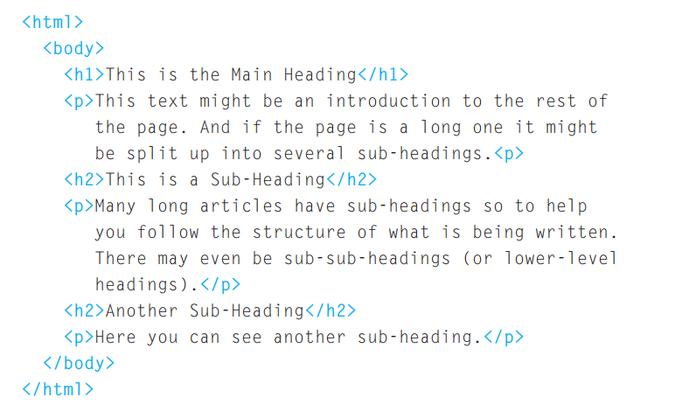

Slide 6
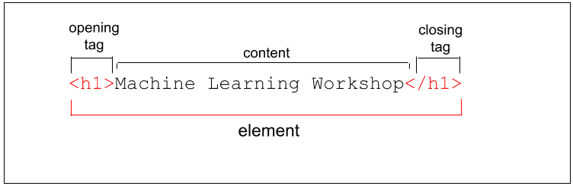
structure
HTML Uses Elements to Describe the Structure of Pages
Each element has an opening tag and a closing tag.

Slide 7
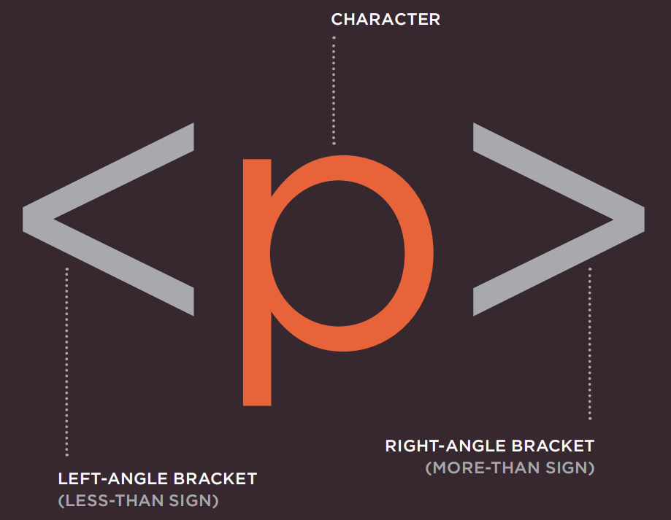
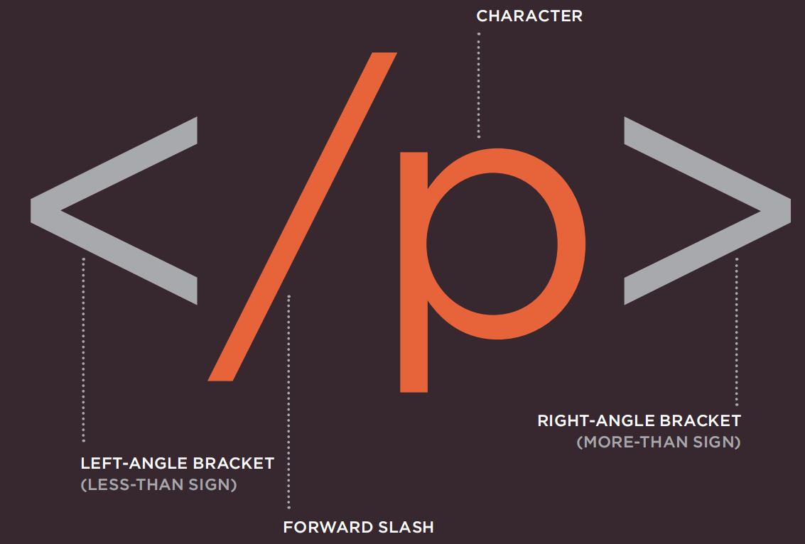
A Closer Look at Tags
Tags act like containers. They tell you something about the information that lies between their opening and closing tags.

Slide 8
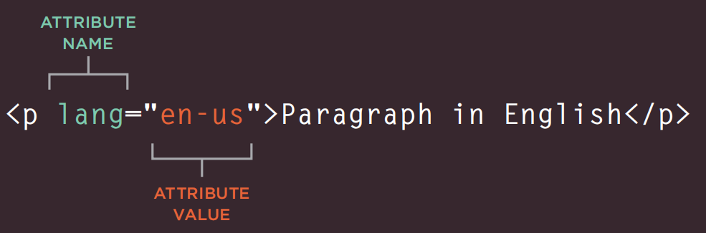
Attributes Tell Us More About Elements
Attributes provide additional information about the contents of an element.
They appear on the opening tag of the element and are made up of two parts: a name and a value, separated by an equals sign.

Slide 9
Body, Head & Title
<body> Everything inside this element is shown inside the main browser window.
<head> Before the <body> element you will often see a <head> element. This contains information about the page
You will usually find a <title> element inside the <head> element.
The contents of the <title> element are either shown in the top of the browser, above where you usually type in the URL of the page you want to visit, or on the tab for that page

Slide 10
Summary
HTML pages are text documents.
HTML uses tags to give the information they surround special meaning
Tags are often referred to as elements.
Tags usually come in pairs.
Opening tags can carry attributes, which tell us more about the content of that element.
Attributes require a name and a value.
To learn HTML you need to know what tags are available for you to use, what they do, and where they can go.

